Slide 1
Asthma Surveillance: A focus on children
Jeanne Moorman, NCEH
Survey Statistician
Lara Akinbami, NCHS
Medical Officer
National Center for Environmental Health; National Center for Health Statistics
Air Pollution and Respiratory Health Branch

Slide 2
National Asthma Program NACP
Components:
Surveillance
Partnerships
Research

Slide 3
Goals for today
Overview of asthma surveillance data sources
Overview of surveillance results, focusing on children
Trends over time
Comparisons by age groups
Comparisons by sex, race, poverty

Slide 4
Why we do asthma surveillance
To establish a baseline level against which to measure trends
To focus effort in areas of greatest need
To contribute to the evaluation of asthma control efforts

Slide 5
NACP Surveillance Activities
Periodic Surveillance Reports
Analysis of existing data
New Data Sources
Add to, revise and refine asthma questions on existing surveys
New Data Systems
National Asthma survey
BRFSS asthma call-back

Slide 6
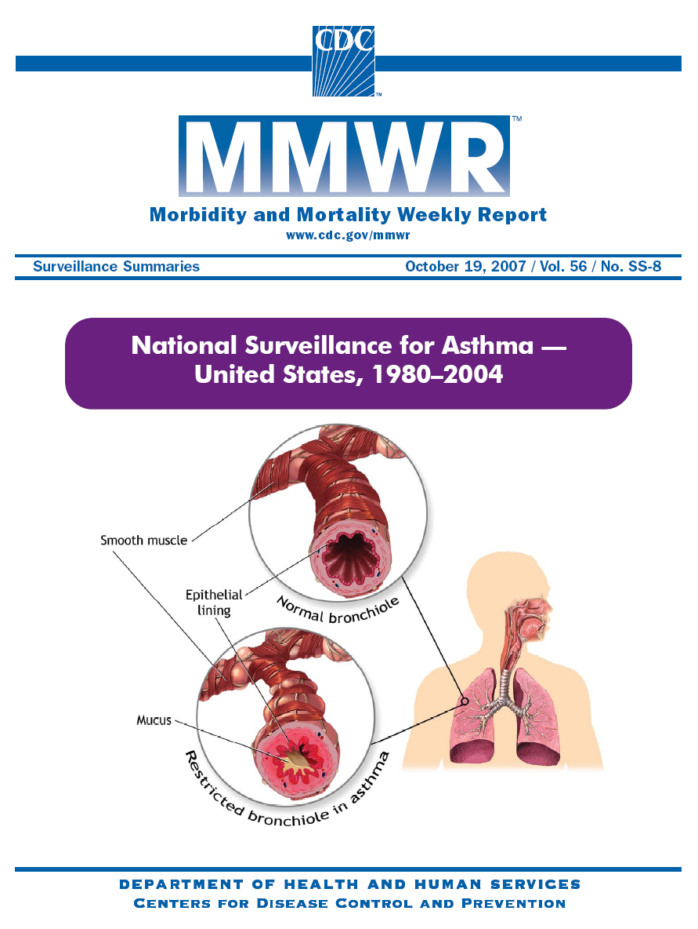
National Asthma Surveillance
Prevalence
Mortality
Hospitalization
Outpatient visits
ED visits
Physician office visits

Slide 7
New Data Sources
Questions on asthma added to:
NHIS supplement
BRFSS
Longitudinal Survey of Youth
HRSA Child Health Survey
YTS and YRBS school-based surveys
Planned survey of farm operators

Slide 8
New Data System
Formerly: National Asthma Survey
Now: BRFSS Asthma Call-Back Survey
Large N for each area
State and city level data
Consistent, detailed asthma data
Formerly a stand alone survey now a call-back subsequent to BRFSS
Not all states participate (35-40)

Slide 9
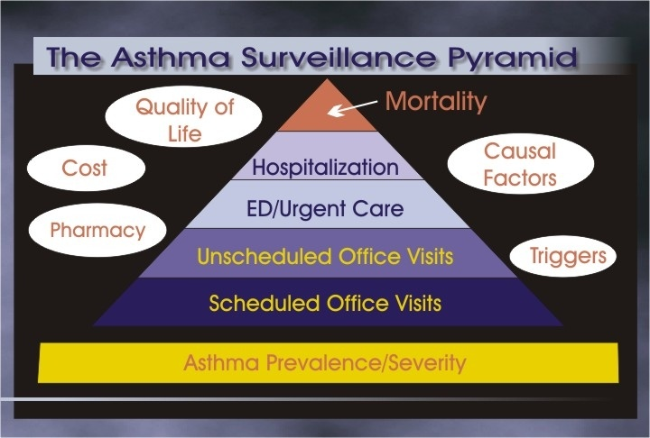

Slide 10
National Datasets of Importance to Asthma Surveillance and Research
National Health Interview Survey (NHIS)
National Vital Statistics System (NVSS)
National Hospital Discharge Survey (NHDS)
National Ambulatory Medical Care Survey (NAMCS)
National Hospital Ambulatory Medical Care Survey (NHAMCS)
National Health and Nutrition Examination Survey (NHANES)

Slide 11
Asthma Surveillance Measures
Prevalence
Lifetime
Current
Attack
Encounters:
Office visits
Hospital outpatient visits
Emergency room visits
Hospitalizations
Deaths

Slide 12
Where do we get prevalence data?
Self reported survey data (NHIS)
Adult self report
Child by adult proxy
Current questions:
Ever told by a doctor (lifetime asthma)
Still have asthma (current asthma)
Had an attack in the past 12 months

Slide 13
National Health Interview Survey (NHIS)
Asthma measure: prevalence
Conducted continuously by NCHS
Purpose: monitor health of U.S. population
Covers civilian non-institutionalized population
Cross-sectional household interview survey; multi-stage area probability sample design
Based on adult self-report only since 1997
Some adult proxy reports before
Child reports always by adult proxy

Slide 14
1997 NHIS Redesign Changes for Asthma
Pre 1997
Incidence (very rough)
12-Month prevalence:
“During past 12 months, did anyone in the family have asthma?”
Post 1997
Lifetime prevalence:
“Has a Doctor or other health professional ever told you that you have asthma?”
Attack Prevalence:
If ever diagnosed, asked “During past 12 months, had episode of asthma or asthma attack?”
Current prevalence, 2001+
If ever diagnosed, asked “Do you still have asthma?”

Slide 15
Asthma Prevalence United States: 1980-2008
Lifetime
Current
12-Month
Attack
Source: NHIS; National Center for Health Statistics

Slide 16
Child Asthma Prevalence United States: 1980-2008
Lifetime
12-Month
Current
Attack
Source: NHIS; National Center for Health Statistics

Slide 17
Current Asthma Prevalence by Age and Sex: 2008
*
*
*
*
*
Source: NHIS; National Center for Health Statistics

Slide 18
Current Asthma Prevalence among Children by demographic characteristics: 2006-2008
*
*
*
*
*
*
* * two-sided significance test significant at the 0.05 level compared to first category in group
AIAN=American Indian/Alaska Native
MSA=metropolitan statistical area
Data Source: CDC/NCHS: National Health Interview Survey (NHIS)

Slide 19
Current Asthma Prevalence among Children by Race/ethnicity and Poverty: 2006-2008
*
*
*
*
*
*
*
*
*
*
*
* two-sided significance test significant at the 0.05 level compared to non-Hispanic white
Data Source: CDC: Health Data Interactive www.cdc.gov/nchs/hdi.htm

Slide 20
Asthma Attacks among People with Asthma, by Age and Sex: 2008
*
Source: NHIS; National Center for Health Statistics

Slide 21
Asthma Attacks Rates among all Children by demographic characteristics: 2006-2008
*
*
*
*
*
* * two-sided significance test significant at the 0.05 level compared to first category in group
AIAN=American Indian/Alaska Native
MSA=metropolitan statistical area
Data Source: CDC/NCHS: National Health Interview Survey (NHIS)

Slide 22
Asthma attack prevalence among all Children by race/ethnicity and poverty: 2006-2008
*
*
*
*
*
*
* two-sided significance test significant at the 0.05 level compared to non-Hispanic white
Data Source: CDC: Health Data Interactive www.cdc.gov/nchs/hdi.htm

Slide 23
Asthma Attacks among Children with Asthma by race/ethnicity and poverty: 2006-2008
Data Source: CDC: Health Data Interactive www.cdc.gov/nchs/hdi.htm

Slide 24
Additional Asthma Content - NHIS
1994 follow-back there is greater detail
1999 15 “periodic” questions were asked
2001 HP2010 module started, but pulled
2002 5 - questions
ER, work/school loss, preventive meds, management plan, environment changes
2003 - HP2010 asthma module 15 questions
ER, work/school loss, medication, inhaler, management plan, environment changes, education, hospitalization
2008 - HP2010 asthma module 15 questions
ER, work/school loss, medication, inhaler, management plan, environment changes, education, hospitalization

Slide 25
Asthma Education among People with Asthma by Age group: 2008
*
*
*
*
Source: NHIS; National Center for Health Statistics

Slide 26
Asthma Education among Children with Asthma by select characteristics: 2008
*
*
*
Class
A. Plan
* two-sided significance test significant at the 0.05 level
Data Source: CDC/NCHS: National Health Interview Survey (NHIS)

Slide 27
Asthma Medication Use among Children with Asthma: 2003 & 2008
*
*
Too much Rescue
Daily Control
* two-sided test significant at the 0.05 level
Data Source: CDC/NCHS: National Health Interview Survey (NHIS)

Slide 28
Percent with missed school days due to asthma, children ages 5-17 years with at least one asthma attack in past 12 months, 2002-2003
*
*
*
*
*
* two-sided test significant at the 0.05 level compared to the last category in each group
Data Source: CDC/NCHS: National Health Interview Survey (NHIS)

Slide 29
Asthma Surveillance Measures
Prevalence
Lifetime
Current
Attack
Encounters:
Office visits
Hospital outpatient visits
Emergency room visits
Hospitalizations
Deaths

Slide 30
Where do we get national encounter data?
NAMCS
Physician Office visit survey
NHAMCS
Hospital Outpatient department visits
Hospital Emergency department visits
NHDS
Hospital inpatient stays

Slide 31
National Ambulatory Medical Care Survey (NAMCS)
Asthma measure: office visits
Conducted annually by NCHS since 1989; prior, conducted from 1973-1981 and in 1985
Sample of visits to nonfederally employed office-based physicians primarily engaged in direct patient care
Excludes physicians in the specialties of anesthesiology, pathology, and radiology
Data collected by physician, rather than patient
Multistage probability design

Slide 32
National Hospital Ambulatory Medical Care Survey (NHAMCS)
Asthma measure: ED and Hospital outpatient clinic visits
Conducted annually by NCHS since 1992
Sample of visits to emergency departments and outpatient departments of non-institutional general and short-stay hospitals
Excludes Federal, military, and V.A. hospitals
Data collected by hospital staff
Multistage probability design

Slide 33
National Hospital Discharge Survey (NHDS)
Asthma measure: hospitalizations
Conducted annually by NCHS
Encompasses patients discharged from non-institutional hospitals
Excludes military and V.A. hospitals
Includes only hospitals with 6 or more beds
Prior to 1988, included only hospitals where average stay < 30 days
1988 redesign: all general and children’s general hospitals included regardless of length of stay
Complex multi-stage sample design

Slide 34
Asthma* Office Visits and Rates#: 1992 – 2008
Source: NAMCS, National Center for Health Statistics
* First-listed diagnosis
# Age-adjusted to 2000 U.S. population

Slide 35
Asthma Office Visit Rates for People with Asthma by Age and Sex: 2006-2008
Source: NHDS; National Center for Health Statistics
- First-listed diagnosis

Slide 36
Asthma Office Visit Rates for Children with Asthma by demographic characteristics: 2006-2008
*
* two-sided significance test significant at the 0.05 level compared to first category in group
Data Source: CDC/NCHS: National Ambulatory Medical Care Survey (NAMC)

Slide 37
Asthma* Outpatient Department Visits and Rates#: 1992 - 2008
Source: NHAMCS; National Center for Health Statistics
* First-listed diagnosis
# Age-adjusted to 2000 U.S. population

Slide 38
Asthma Outpatient Department Visit Rates for People with Asthma by Age and Sex: 2006-2008
*
*
Source: NHAMCS; National Center for Health Statistics
- First-listed diagnosis

Slide 39
Asthma Outpatient Visits for Children with Asthma by demographic characteristics: 2006-2008
* two-sided significance test significant at the 0.05 level compared to first category in group
Data Source: CDC/NCHS: National Hospital Ambulatory Medical Care Survey (NHAMC)

Slide 40
Asthma* Emergency Department Visits and Rates#: 1992 - 2008
Source: NHAMCS; National Center for Health Statistics
* First-listed diagnosis
# Age-adjusted to 2000 U.S. population

Slide 41
Asthma Emergency Department Visit Rates for People with Asthma by Age and Sex: 2006-2008
Source: NHDS; National Center for Health Statistics
- First-listed diagnosis

Slide 42
Asthma ED Visits for Children with Asthma by demographic characteristics: 2006-2008
*
*
* two-sided significance test significant at the 0.05 level compared to first category in group
Data Source: CDC/NCHS: National Hospital Ambulatory Medical Care Survey (NHAMC)

Slide 43
Asthma* Hospital Discharges and Rates#: 1980 - 2007
Source: NHDS; National Center for Health Statistics
* First-listed diagnosis
# Age-adjusted to 2000 U.S. population

Slide 44
Asthma Hospitalizations per 100 People with Asthma by Age and Sex: 2005-2007
*
Source: NHDS; National Center for Health Statistics
- First-listed diagnosis

Slide 45
Asthma Hospitalizations for Children with Asthma by demographic characteristics: 2005-2007
*
* two-sided significance test significant at the 0.05 level compared to first category in group
Data Source: CDC/NCHS: National Hospital Discharge Survey (NHDS)

Slide 46
Asthma Encounters* for People with Asthma by Age: 2006-2008
*Per 100 with current asthma

Slide 47
Asthma Encounters* for Children with Asthma by Sex, Race, and Ethnicity: 2006-2008
*Per 100 children with current asthma

Slide 48
Asthma Surveillance Measures
Prevalence
Lifetime
Current
Attack
Encounters:
Office visits
Hospital outpatient visits
Emergency room visits
Hospitalizations
Deaths

Slide 49
National Vital Statistics System (NVSS)
Asthma measure: mortality
Cooperative effort between NCHS, states
NVSS represents federal compilation of data for deaths as mandated by law
Represents report of all deaths
Data available
for small geographic areas
over a long period of time

Slide 50
Asthma Mortality Rates* and Number of Deaths: 1979-2007
ICD-9
ICD-10
Source: NVSS; National Center for Health Statistics
* Age-adjusted to 2000 U.S. population

Slide 51
Asthma Mortality Rates* by Age: 1979-2007
ICD-9
ICD-10
65+
35 - 64
5 - 34
Source: NVSS; National Center for Health Statistics
* Age-adjusted to 2000 U.S. population

Slide 52
Asthma Mortality Rates* Age 65+ by Sex: 1979-2006
ICD-9
ICD-10
Female
Male
Source: NVSS; National Center for Health Statistics
* Age-adjusted to 2000 U.S. population

Slide 53
Asthma Mortality Rate for People with Asthma by Age and Sex: 2005-2007
*
*
*
Data Source: CDC/NCHS: National Vital Statistics System

Slide 54
Asthma Mortality for Children with Asthma by Demographic Characteristics: 2005-2007
*
*
* two-sided significance test significant at the 0.05 level compared to first category in group
Data Source: CDC/NCHS: National Vital Statistics System

Slide 55
Trends in asthma prevalence and outcomes among children
Prevalence
Current asthma prevalence
Attack prevalence
Healthcare use and death
Asthma action plans
Differences by gender, poverty status, and race/ethnicity

Slide 56
Current Asthma Prevalence by Age and Sex, 2001-2009

Slide 57
Trends in current asthma prevalence among children, by gender, 2001-2009

Slide 58
Trends in current asthma prevalence among children, by gender, 2001-2009

Slide 59
Trends in current asthma prevalence among children, by poverty status, 2001-2009

Slide 60
Trends in current asthma prevalence among children, by poverty status, 2001-2009

Slide 61
Trends in childhood current asthma prevalence by race/ethnicity, 2001-2009

Slide 62
Trends in childhood current asthma prevalence by race/ethnicity, 2001-2009

Slide 63
Relative risk of asthma diagnosis among symptomatic children 3-17 years old, 1999 NHIS
 | % diagnosed | Relative risk
White | 57% | 1.00 (reference)
Black | 72% | 1.24 (1.07, 1.38)
Puerto Rican | 86% | 1.45 (1.12, 1.63)
Mexican | 65% | 1.15 (0.94, 1.32)
The relative risk is unadjusted. There was little change after adjusting for age, income, parental education, central city residence, insurance, and source of care

Slide 64
Trends in attack prevalence among children, by gender, 2001-2009

Slide 65
Trends in attack prevalence among children, by gender, 2001-2009

Slide 66
Trends in attack prevalence among children, by poverty status, 2001-2009

Slide 67
Trends in attack prevalence among children, by poverty status, 2001-2009

Slide 68
Trends in childhood asthma attack prevalence by race/ethnicity, 2001-2009

Slide 69
Trends in childhood asthma attack prevalence by race/ethnicity, 2001-2009

Slide 70
Trends in childhood attack prevalence among children with asthma, by race/ethnicity, 2001-2009

Slide 71
Trends in childhood attack prevalence among children with asthma, by race/ethnicity, 2001-2009

Slide 72
Trends in emergency room visits among children with ≥1 attack past 12 months, by race/ethnicity, 2001-2009

Slide 73
Trends in emergency room visits among children with ≥1 attack past 12 months, by race/ethnicity, 2001-2009

Slide 74
Disparities in outcomes among children with asthma, by race/ethnicity, 2003-2004
Emergency dept visits
Ambulatory visits
Hospitalization^{b}
Current prevalence
Death
Rates for Hispanic children are not reliable
Hispanic ethnicity is not available, the ratio is shown for black/white

Slide 75
Trends in asthma hospitalizations among children with asthma, by race, 2001-2005

Slide 76
Trends in asthma death rates among children with asthma, by race, 2001-2005

Slide 77
Asthma management plan among children 3-17 years, by poverty status, 2003 vs. 2008
No 2003 to 2008 comparisons were statistically significant
Poverty group comparison p-value<0.05 in 2003, p-value=0.06 in 2008

Slide 78
Asthma management plan among children 3-17 years, by race/ethnicity, 2003 vs. 2008
No 2003 to 2008 comparisons were statistically significant
No significant differences between race/ethnic groups

Slide 79
Review: Trends in differences
Current asthma prevalence race/ethnic differences show ↑ trend
Attack prevalence among children with asthma, a crude indicator of control, may have improved and has low race/ethnic disparity
But % with an ED visit, an available severity measure, shows large, robust race/ethnic disparities
An adverse outcomes snapshot (ED, hospitalizations, death) shows large race/ethnic disparities even after taking prevalence differences into account
Trends in hospitalizations and deaths show improvements although disparities haven’t always declined

Slide 80
Review: Child Prevalence
Increasing over time
Lifetime
12-month
Current
Current asthma is higher
in boys
in the poor
in Puerto Rican Hispanics

Slide 81
Review: Child Asthma
Among children with asthma
there is no difference in asthma attacks by sex, race or poverty level
Children are more likely than adults to have 4 types of asthma education
Black children are more likely to have formal asthma education than white or Hispanic children
Children with private insurance are more likely to have an asthma action plan

Slide 82
Review: Encounters for children
Office visits
Higher among children than adults
Higher among boys than girls
Higher among white children than black children
Higher in the south
Outpatient, ED, & Hospitalizations
Highest among those age 0-4
Higher among children than adults
Higher among black and Hispanic children

Slide 83
Review: Child Asthma Deaths
Deaths are relatively rare in children
Fewer than 200 a year
Black children have higher asthma mortality
Child asthma death investigations have not isolated a satisfactory explanatory factor
Some evidence of noncompliance with prescribed medication

Slide 85
Contact information
Jeanne: JMoorman@cdc.gov
Lara: LAkinbami@cdc.gov
National Center for Environmental Health
Division of Environmental Hazards and Health Effects

